Slide 1
VM Stress Calculation
Plan
28th July 2017

Slide 2
Introduction
Need a python code to evaluate von Mises stress per API-RP-2RD
Utilization tension vs. bending curves with varying pressure are also required

Slide 3
Introduction
Need a python code to evaluate von Mises stress per API-RP-2RD
Utilization tension vs. bending curves with varying pressure are also required

Slide 4

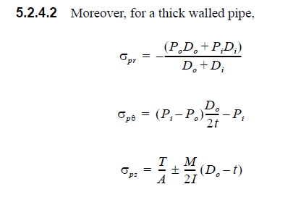
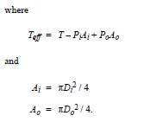
Theory
The vm stress is given below:
Each individual stress components are evaluated below

Slide 5
Way Forward
??

Slide 6
THANK YOU
For the opportunity to serve!

Slide 7
Document Revision History
01 | New Document | 28th June 2017 |  | VK
Rev | Description | Date |  | Author | Checked | Approved
Document No: |  |  | Client Ref:

